Slide 1
Fenwick Tree
(binary indexed tree)

Slide 2
The Problem
There are several boxes
Labeled from 1 to N
We can
Add N marble(s) into i^{th} box
We say box #i has frequency N
We want to know
Total number of marbles in box #1 to #j

Slide 3
Fenwick Tree
Operation
void create(int n); O(N)
void update(int idx, int val); O(log N)
int freqTo(int idx); O(log N)
int freqAt(int idx); O(log N)

Slide 4
Storage
Data
An int array of size N

Slide 5
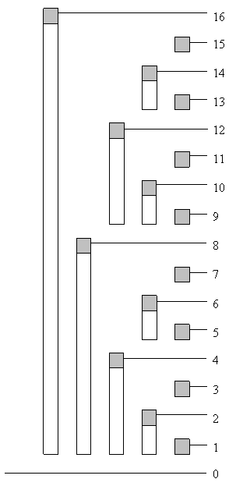
Fenwick Tree
How it works?
Each element in the array stores cumulative frequency of consecutive list of boxes
Range of boxes that is stored is related to “binary value” of the index
pic from www.topcoder.com

Slide 6
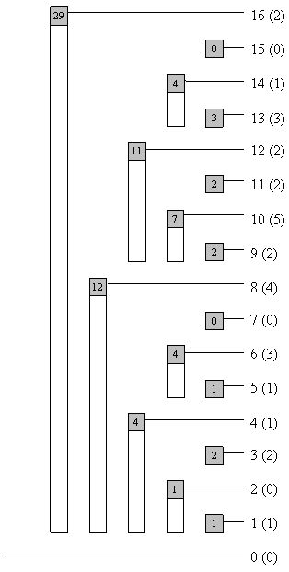
Define
f(x) = number of marble in box x
c(x) = summation of number of marble in box #1 to box #x
tree[x] = element x in the array

Slide 7
Storage Solution
Tree[16] = f(1) + f(2) + … + f(16)
Tree[12] = f(9) + f(10) + … + f(12)
Tree[6] = f(5) + f(6)
Tree[3] = f(3)

Slide 8
Cumulative Freq
f(16) = 2
Actual frequency
tree[16] = 29
Index of the array
Cumulative frequency
From 1 to 16
tree[14]
Cumulative frequency
From 13 to 14
pic from www.topcoder.com

Slide 9
The last 1
A node at the index X will store freq of boxes in the range
X – 2^{r}+1 to X
Where r is the position of the last digit of 1
Ex
X = 12 (1100)₂
Node will store freq from 9 to 12
The last 1 of 12 is at position 2 (0-indexed)
12 – 2² + 1 = 9 = (1001)₂

Slide 10
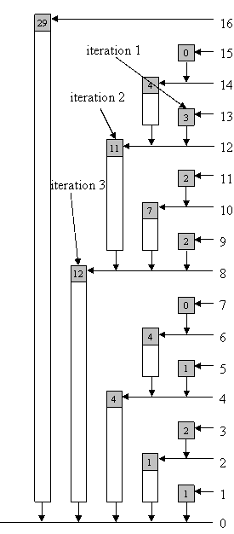
Read Cumulative Freq
c(13) =
tree[13] +
tree[12] +
tree[8]
In base-2
c(1101₂) =
tree[1101₂] +
tree[1100₂] +
tree[1000₂]
pic from www.topcoder.com

Slide 11
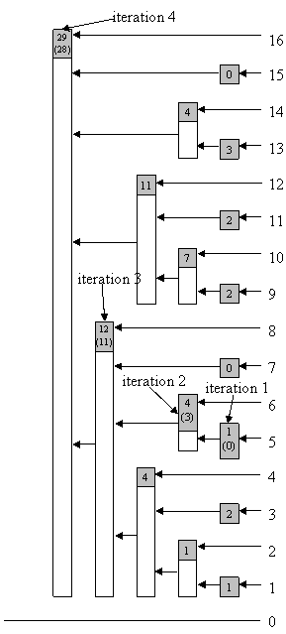
Update Freq
Update f(5) by -1
involve
Tree[16] (10000₂)
Tree[8] (01000₂)
Tree[6] (00110₂)
Tree[5] (00101₂)
pic from www.topcoder.com

Slide 12
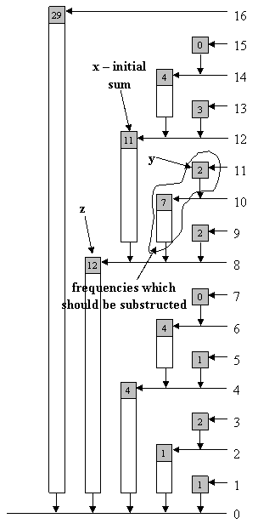
Read actual Freq
What is f(12)?
Easy, it’s c(12) – c(11)
easier
Tree[12] = f(9) + f(10) + f(11) + f(12)
Tree[11] = f(11)
Tree[10] = f(9) + f(10)
Hence,
f(12) = Tree[12] – Tree[11] – Tree[10]
pic from www.topcoder.com

Slide 13
Two’s compliment
0111 | 7
0110 | 6
0101 | 5
0100 | 4
0011 | 3
0010 | 2
0001 | 1
0000 | 0
1111 | −1
1110 | −2
1101 | −3
1100 | −4
1011 | −5
1010 | −6
1001 | −7
1000 | −8
A method to represent negative
A two’s compliment of X is
(compliment of x) + 1
Ex.. 2’s Compliment of 7 is
0111 ➔ 1000 ➔ 1001
Finding the last 1
x = a1b
b = consecutive of 0
Ex… X = 4 = 0100
a = 0 b = 00

Slide 14
Two’s compliment
0111 | 7
0110 | 6
0101 | 5
0100 | 4
0011 | 3
0010 | 2
0001 | 1
0000 | 0
1111 | −1
1110 | −2
1101 | −3
1100 | −4
1011 | −5
1010 | −6
1001 | −7
1000 | −8
Now, let’s see two’s compliment more closely
-x
= (a1b)¯ + 1
= a¯0b¯ + 1
= a¯0(0...0)¯ + 1
= a¯0(1...1) + 1
= a¯1(0...0)
= a¯1b.
So, if we “&” –x and x
a¯1b & a1b.
We got the last 1

Slide 15
Code
int freqTo(int idx) {
int sum = 0;
while (idx > 0){
sum += tree[idx];
idx -= (idx & -idx);
}
return sum;
}
void update(int idx ,int val) {
while (idx <= MaxVal){
tree[idx] += val;
idx += (idx & -idx);
}
}
from www.topcoder.com

Slide 16
Code
int freqAt(int idx){
int sum = tree[idx];
if (idx > 0) {
int z = idx - (idx & -idx);
y = idx - 1;
while (y != z){
sum -= tree[y];
y -= (y & -y);
}
}
return sum;
}
from www.topcoder.com

Slide 17
2D BIT
Box is arrange at x-y coordinate
Operation
Update(x,y,val) (add “val” marble in position (x,y))
How many points in the range (x1,y1) to (x2,y2)

Slide 18
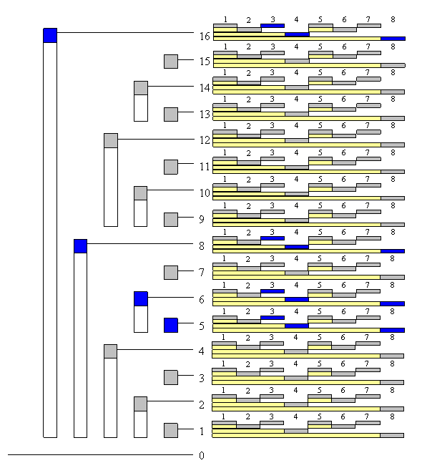
2D BIT
pic from www.topcoder.com

